Slide 1
MIYE Presentation – Milestone 2 -CaliTech Consulting December 5, 2019
By Sango Fon

Slide 2

Introduction

Slide 3
MIYE USER STORIES
CREATE A GROUP
01
Employee is able to create a group name for a reservation.
GROUP SCHEDULING
02
Employee will be able to create a group account and add a group of clients at once.
ADD NEW GROUP MEMBERSHIPS
03
Employee will be able to register an individual under a distinct group name.
PRINT GROUP BILL
04
The employee will be able to print the group bill.
PRINT WEEKLY AUDIT
05
Administrator will be able to print a weekly audit sheet and show cancellations and reservations.

Slide 4
Big Board
User Stories
In Progress
Burn Down
We fixed the bugs of the last user stories and met with the client to confirm the user stories for the added functionalities.
We kept track of our work with and excel sheet where we could list the tasks that needed to be completed and assigned them user story points.
Helpful for staying on track.
Next
Keeps track of the next steps.
Unplanned Tasks
Completed
Completed User Stories

Slide 5

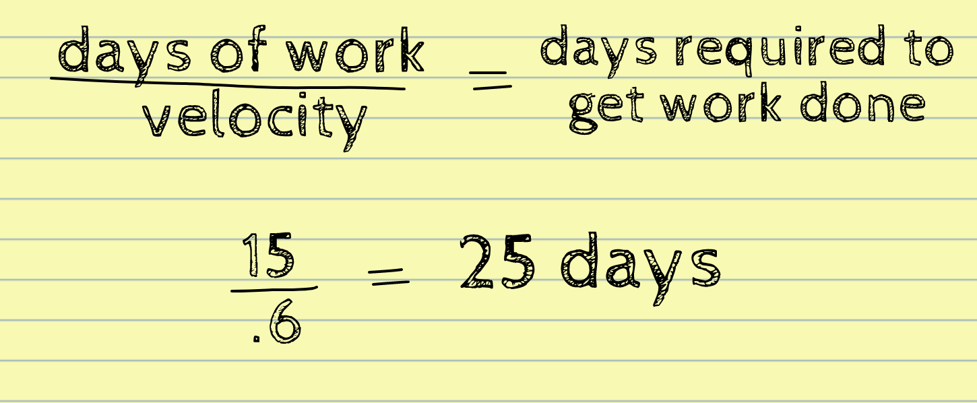
Velocity Testing
Before we began creating our schedule we calculated a realistic estimate.
If you don’t account for overhead ahead of time, you will be behind time in delivering the product.
Notes:
Before we created our schedule we calculated a realistic estimate of the days we would need to complete the iteration. Our at Calitech is “If you don’t account for overhead ahead of time you will be behind time in delivering the product.
You take the days it would take to develop the second iteration and divided it by the the velocity which is between 0 and .7. An average velocity is .7 but since we also have jobs we placed our velocity at .6. The results is 25 days to account for days our time away from development and holidays. So 25 days of work is 15 days of productive time.

Slide 6
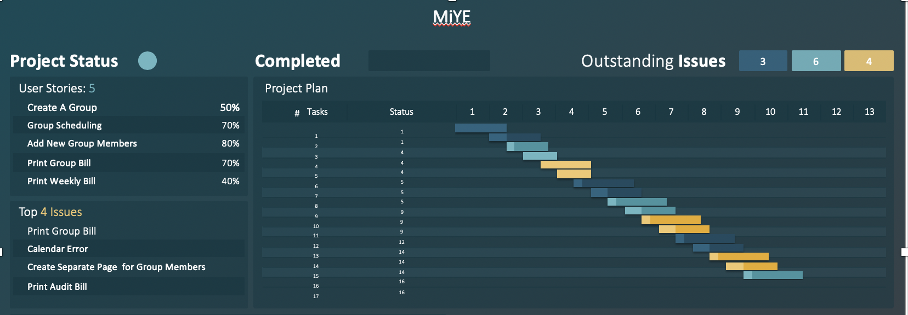
Management of Activities

Slide 7
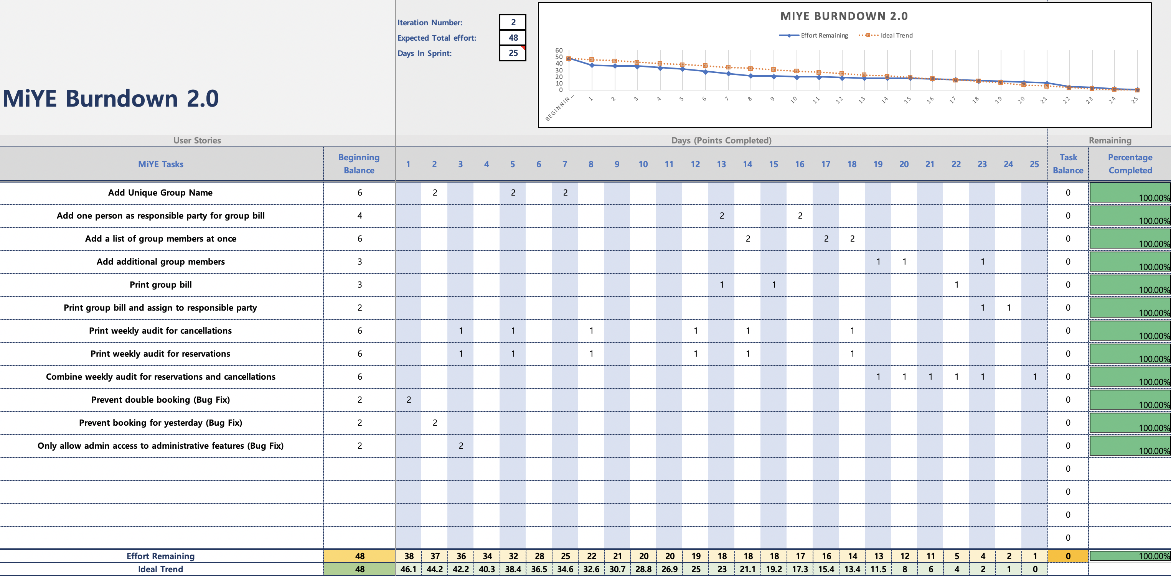
Burndown 2.0

Slide 8
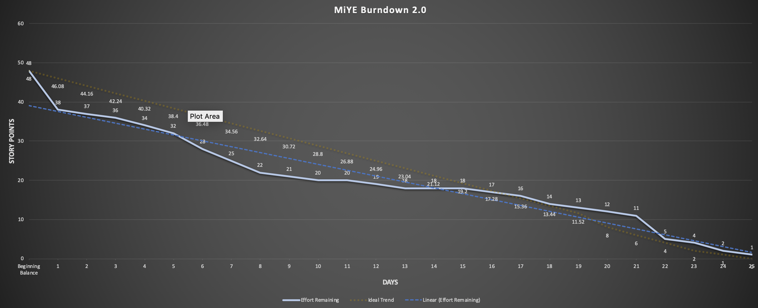
Burndown 2.0

Slide 9
Testing Process
White-box
Simple Unit Test within Application Per User Story
Grey-box
PyTest Module (MIYE_Test.py).
Black-box
Ran Application from non-development workstation without internet access.
Create Black Test for User Stories

Slide 10

Regression testing

Slide 11
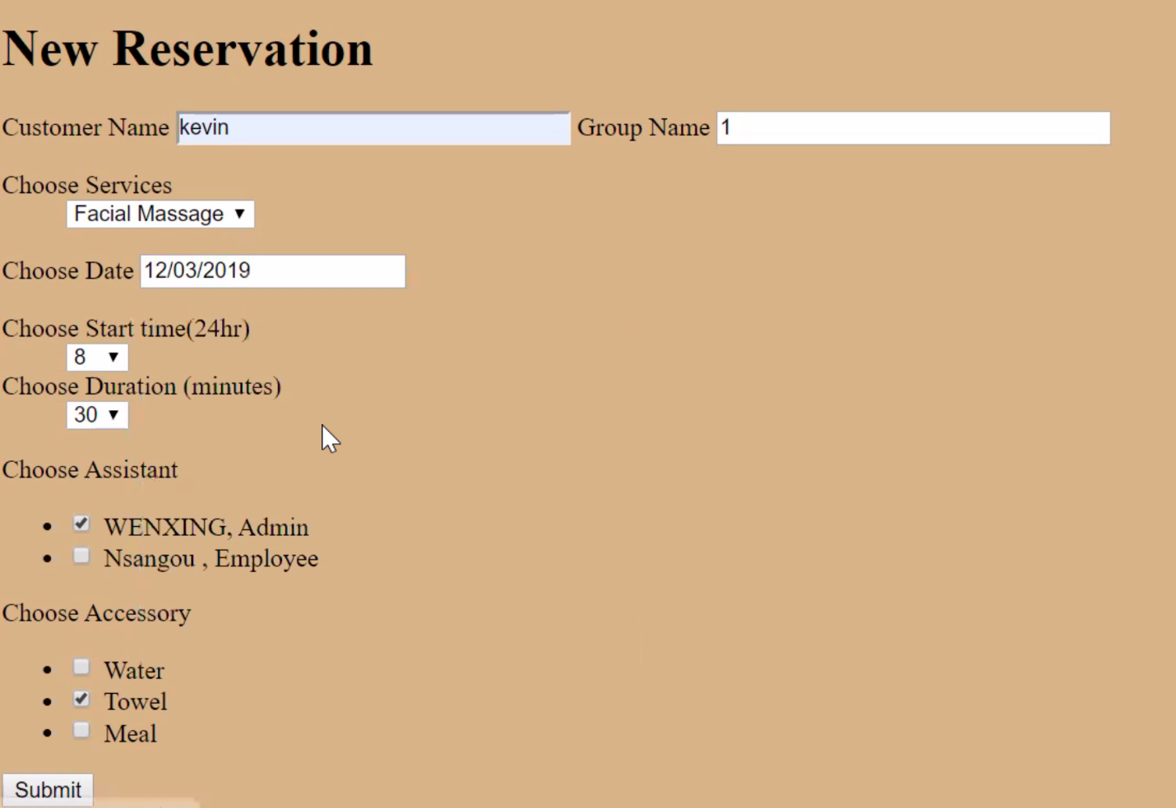
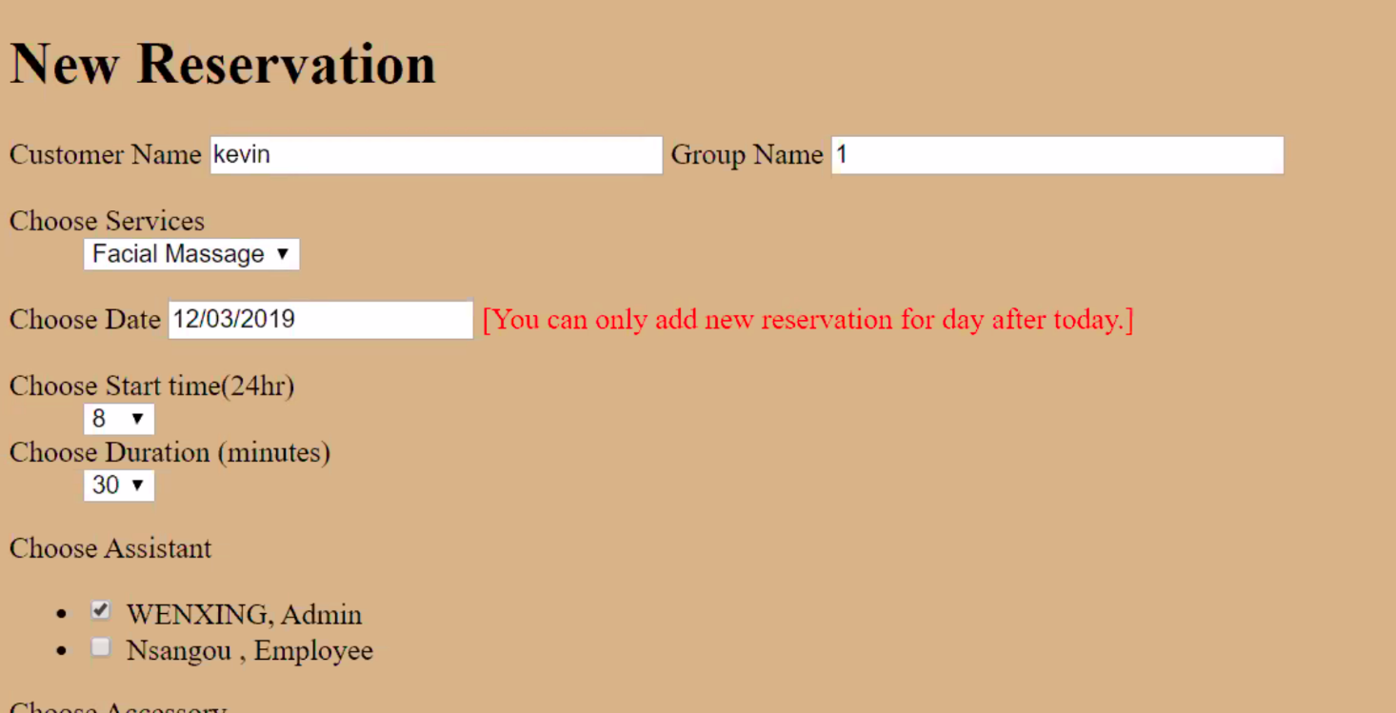
Prevents Booking for Yesterday
Goals
Employee will not be able to book a reservation for yesterday.
Testing Process
Create New Reservation for yesterday

Slide 12
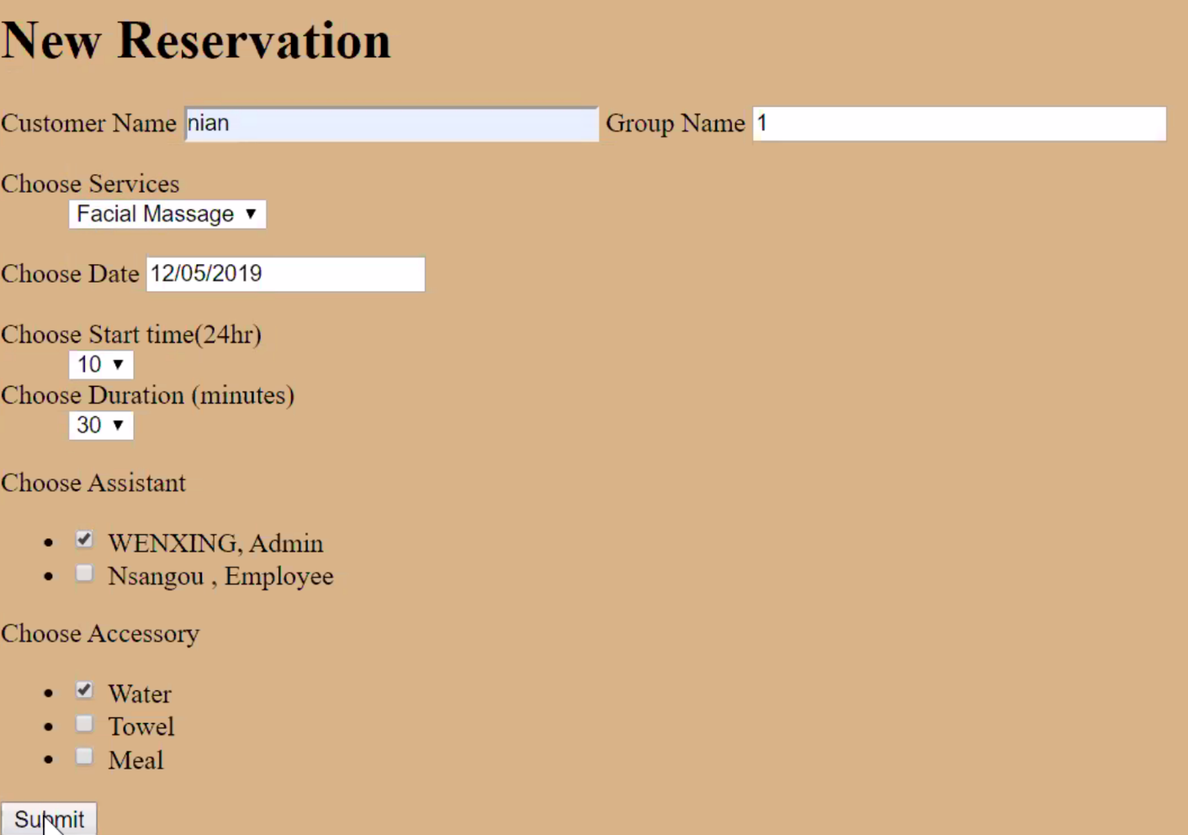
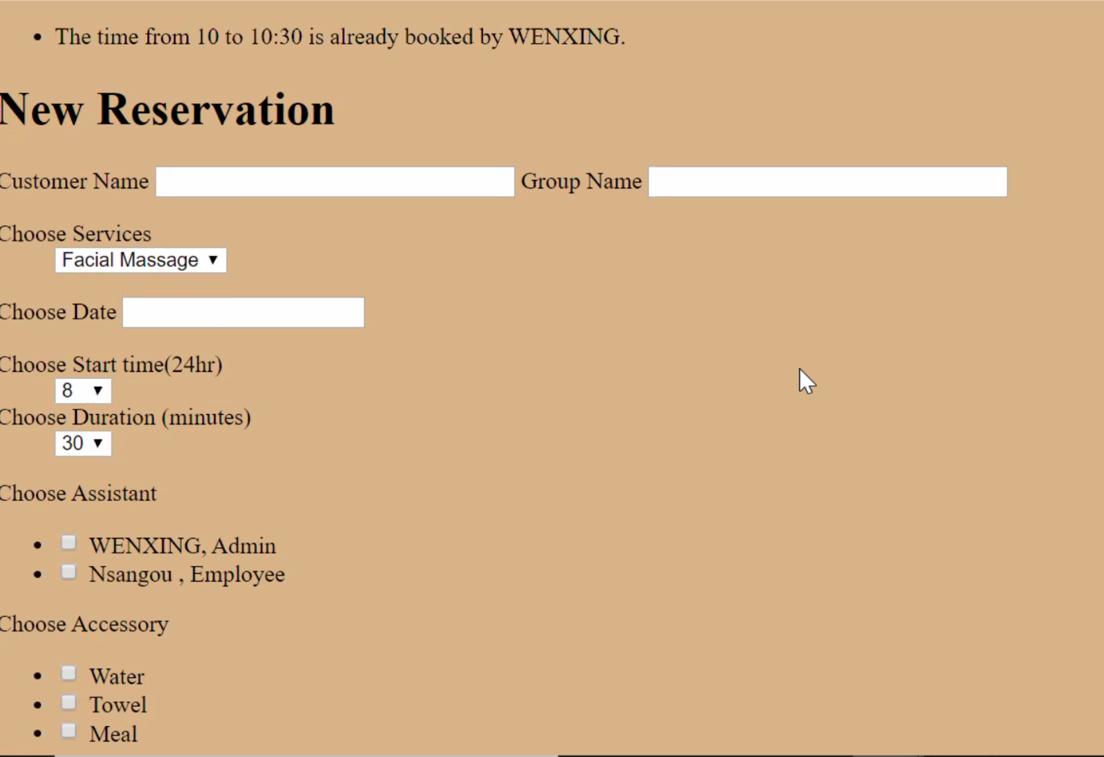
Prevents Double Booking
Goals
Employee will not be able to double book a service.
Testing Process
Create New Reservation
Create New Reservation in same time slot.

Slide 13
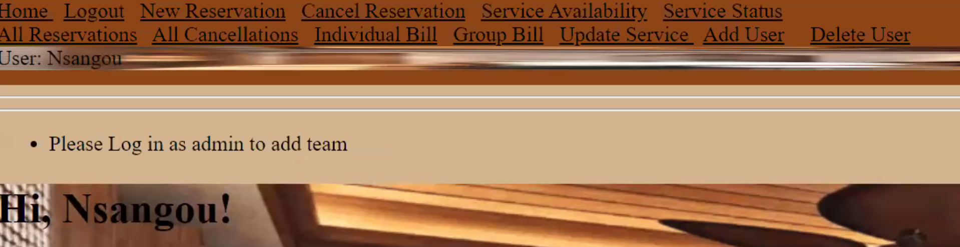
Admin Access
Goals
Employee will not be able to access admin features.
Testing Process
Login as Employee
Have employee try to add user which is an admin function.

Slide 14

Milestones & User Stories

Slide 15
MIYE USER STORIES
CREATE A GROUP
01
Employee is able to create a group name for a reservation.
GROUP SCHEDULING
02
Employee will be able to create a group account and add a group of clients at once.
ADD NEW GROUP MEMBERS
03
Employee will be able to register an individual under a distinct group name.
PRINT GROUP BILL
04
The employee will be able to print the group bill.
PRINT WEEKLY AUDIT
05
Administrator will be able to print a weekly audit sheet and show cancellations and reservations.

Slide 16
Create a Group
CREATE A GROUP
01
Employee is able to create a group name for a reservation.
GROUP SCHEDULING
02
Employee will be able to create a group account and add a group of clients at once.
ADD NEW GROUP MEMBERS
03
Employee will be able to register an individual under a distinct group name.
PRINT GROUP BILL
04
The employee will be able to print the group bill.
PRINT WEEKLY AUDIT
05
Administrator will be able to print a weekly audit sheet and show cancellations and reservations.

Slide 17
Group Scheduling
CREATE A GROUP
01
Employee is able to create a group name for a reservation.
GROUP SCHEDULING
02
Employee will be able to create a group account and add a group of clients at once.
ADD NEW GROUP MEMBERS
03
Employee will be able to register an individual under a distinct group name.
PRINT GROUP BILL
04
The employee will be able to print the group bill.
PRINT WEEKLY AUDIT
05
Administrator will be able to print a weekly audit sheet and show cancellations and reservations.

Slide 18
Add New Group Members
GREATE A GROUP
01
Employee is able to create a group name for a reservation.
GROUP SCHEDULING
02
Employee will be able to create a group account and add a group of clients at once.
ADD NEW GROUP MEMBERS
03
Employee will be able to register an individual under a distinct group name.
PRINT GROUP BILL
04
The employee will be able to print the group bill.
PRINT WEEKLY AUDIT
05
Administrator will be able to print a weekly audit sheet and show cancellations and reservations.

Slide 19
Print Group Bill
CREATE A GROUP
01
Employee is able to create a group name for a reservation.
GROUP SCHEDULING
02
Employee will be able to create a group account and add a group of clients at once.
ADD NEW GROUP MEMBERS
03
Employee will be able to register an individual under a distinct group name.
PRINT GROUP BILL
04
The employee will be able to print the group bill.
PRINT WEEKLY AUDIT
05
Administrator will be able to print a weekly audit sheet and show cancellations and reservations.

Slide 20
Print Weekly Audit
CREATE A GROUP
01
Employee is able to create a group name for a reservation.
GROUP SCHEDULING
02
Employee will be able to create a group account and add a group of clients at once.
ADD NEW GROUP MEMBERS
03
Employee will be able to register an individual under a distinct group name.
PRINT GROUP BILL
04
The employee will be able to print the group bill.
PRINT WEEKLY AUDIT
05
Administrator will be able to print a weekly audit sheet and show cancellations and reservations.

Slide 21

Grey box testing (Unittest)

Slide 22
Testing Process
White-box
Simple Unit Test within Application Per User Story
Grey-box
PyTest Module (MIYE_Test.py).
Black-box
Ran Application from non-development workstation without internet access.
Create Black Test for User Stories

Slide 23
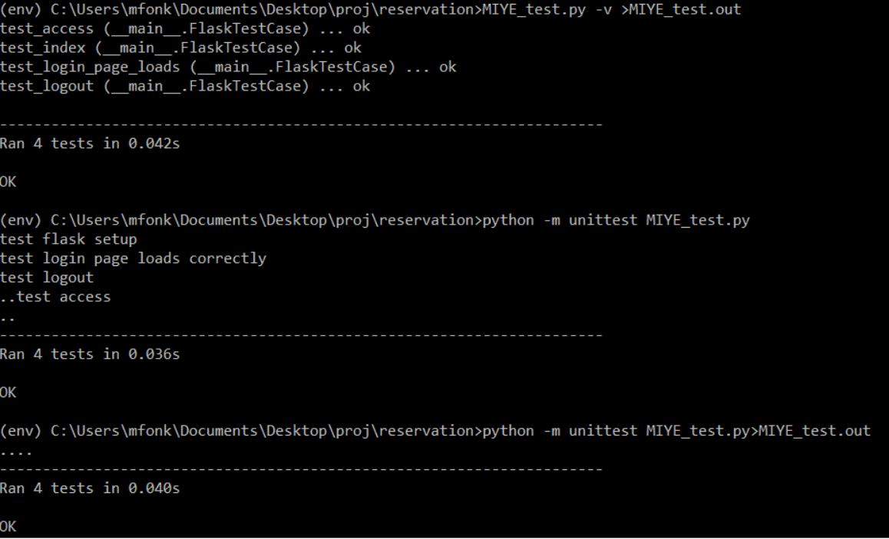

Regression and Unit Testing
Goals
Test Installation of Appropriate Modules and Libraries.
Ensure Overall Function is stable
Testing Process
Create Baseline Test within PyTest process
Ensure Overall Function is stable

Slide 24
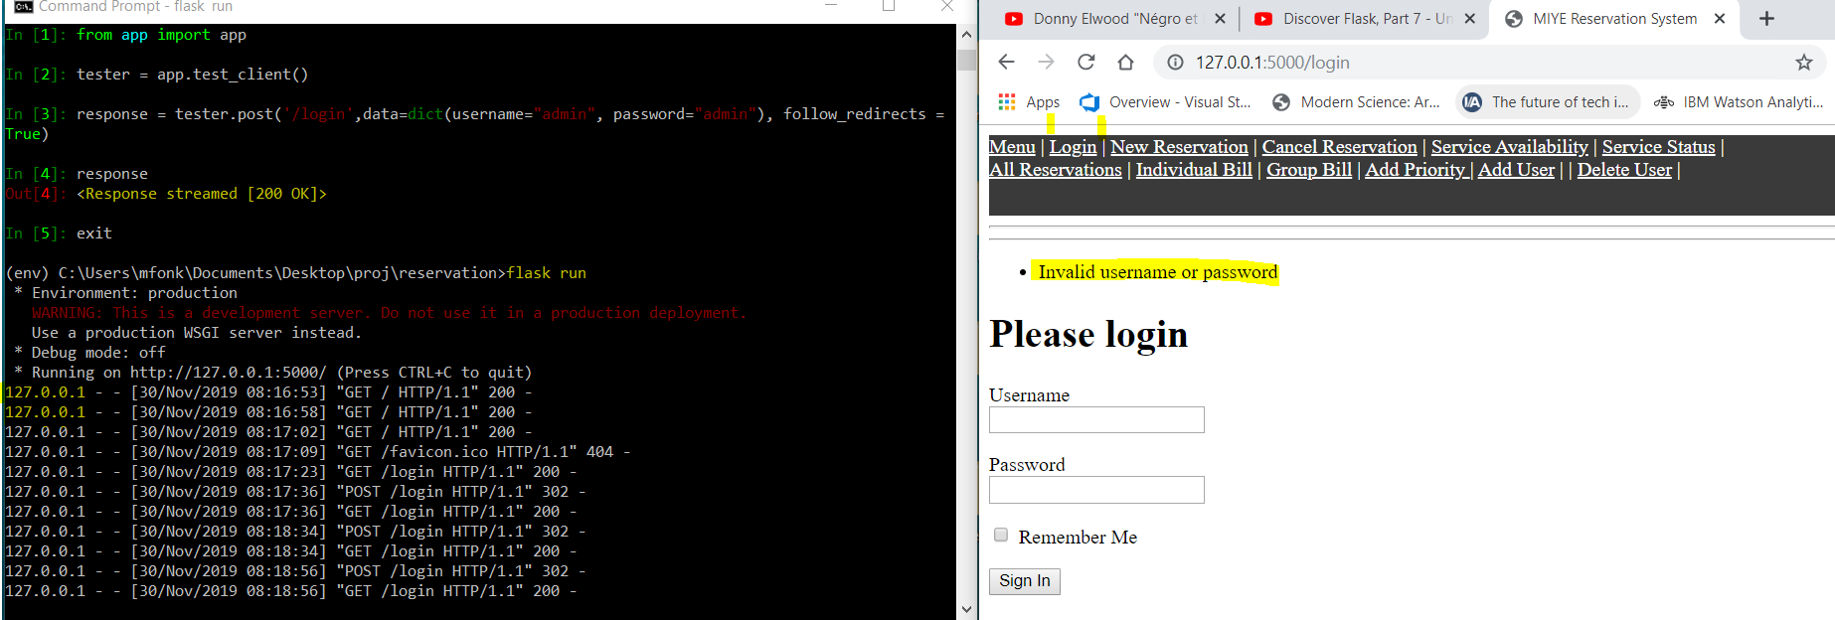
Regression and Unit Testing
Goals
Test Installation of Appropriate Modules and Libraries.
Ensure Overall Function is stable
Testing Process
Create Baseline Test within PyTest process
Ensure Overall Function is stable

Slide 25

Live Demonstration
Grey box testing(Unittest)

Slide 26

Demonstration – live application
For live demo, please download MIYE_APP and follow the instruction on
its readme to successfully launch and explore the APP.

